Slide 1
14. Recursive Search and Sort
1.1–1.2
Notes:
(14.1) Recursive Binary Search
(14.1a) Given an ordered array of values, write a recursive binary search method to locate a specified value in the array. If the value is not present in the array, indicate that.
Identify the base case and the general case in the algorithm.
(14.1b) Count the number of comparisons made when a recursive binary search algorithm is executed and the search key and the array of values are provided.
(14.1c) Identify all elements in a given array that are examined by a recursive binary search algorithm when the search key and the array of values are provided.
(14.1d) Determine the best case, average case, and worst case Big-O analysis for a recursive binary search algorithm when the search key and the array of values are provided.
(14.2) Mergesort and Analysis
(14.2a) Given an array of values, give a step-by-step illustration of executing the mergesorton the array. State the array contents after each pass of the sort. Not crazy about the book’s presentation of this or the book’s code.
(14.2b) Determine the best case, average case, and worst case Big-O analysis of the mergesort.

Slide 2
14. Recursive search and sort
Recursive binary search
Performance analysis
Mergesort
Mergesort analysis

Slide 3
Sorting Algorithms
Insertion sort O(n²)
Best if data is partially sorted
Best case-data sorted O(n)
Selection sort O(n²)
best and worst case are the same

Slide 4
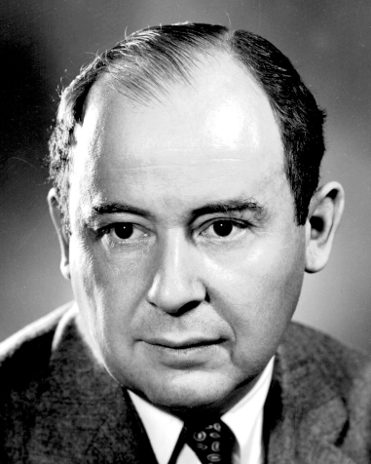
Mergesort algorithm
Mergesort
Divide array into two halves.
Recursively sort each half.
Merge two halves to make sorted whole.
John von Neumann
Pioneered computing (stay tuned).
Early focus on numerical calculations.
Invented mergesort as a test to see how his machine would measure up on other tasks.
John von Neumann
1903–1957

Slide 5
Mergesort
Follows the divide-and-conquer approach
break the problem into several sub-problems that are similar to the original problem but smaller in size
solve the sub-problems recursively
combine the sub-problems solution to create a solution to the original problem

Slide 6
Mergesort
5 | 2 | 4 | 7 | 1 | 3 | 2 | 6
divide
5 | 2 | 4 | 7
1 | 3 | 2 | 6
divide
5 | 2
4 | 7
1 | 3
2 | 6
divide
5
2
4
7
1
3
2
6
merge
2 | 5
4 | 7
1 | 3
2 | 6
merge
2 | 4 | 5 | 7
1 | 2 | 3 | 6
merge
1 | 2 | 2 | 3 | 4 | 5 | 6 | 7

Slide 7
Merge Sort (simpler analysis)n = 2^{m}
elements comp
n/4 n/4 - 1
n/2 n/2 - 1
n
n/n not done
Comparisons:
n + 2(n/2) + 4(n/4) +…+ n(n/n) {m times}
comparisons = n m = O(n log n) (m = log₂n)
https://www.khanacademy.org/computing/computer-science/algorithms/merge-sort/a/analysis-of-merge-sort
Notes:
the running time of mergeSort on an n-element subarray as being the sum of twice the running time of mergeSort on an (n/2)-element subarray (for the conquer step) plus cn (for the divide and combine steps—really for just the merging).

Slide 8
Mergesort
Main idea for an array of n elements:
Divide the unsorted array until there are n arrays, each containing 1 element.
An array with one element is considered sorted.
Repeatedly merge two sorted arrays until there is only 1 array remaining.
This will be the sorted array at the end.

Slide 9
public static void merge (int[] a, int left, int right){
int[] temp = new int[right - left + 1];
if (left >= right ) return; int mid = (left + right)/2;
int i = 0;//fills temp array
int leftIndex = left;
int rightIndex = mid + 1;
while ((leftIndex <= mid) && (rightIndex <= right)){
if (a[leftIndex] <= a[rightIndex]){
temp[i]= a[leftIndex];
leftIndex++;
} else{
temp[i]= a[rightIndex];
rightIndex++;
}
i++;
}
while (leftIndex <= mid){
temp[i] = a[leftIndex];
leftIndex++;
i++;
}
while (rightIndex <= right){
temp[i] = a[rightIndex];
rightIndex++;
i++;
}
for (i = left; i <= right; i++){
a[i] = temp[i-left];
}
}
public static void mergeSort (int[] a, int l, int r){
if (l >= r) return; int middle = (l + r)/ 2; mergeSort(a, l, middle);
mergeSort(a, middle + 1, r);
merge(a, l, r);
}

Slide 10
Lets Practice!
0 | 1 | 2 | 3 | 4 | 5 | 6
12 | 14 | 3 | 8 | 20 | 9 | 26

Slide 11
MERGE
0 | 1 | 2 | 3 | 4 | 5 | 6
12 | 14 | 3 | 8 | 20 | 9 | 26

Slide 12
12 | 14 | 3 | 8 | 20 | 9 | 26
public static void mergeSort (int[] a, int l, int r) {
if (l >= r) return;
int middle = (l + r)/ 2;
mergeSort(a, l, middle);
mergeSort(a, middle + 1, r);
merge2(a, l, r);
printArray(a);
}
12 | 14 | 3 | 8 | 20 | 9 | 26
12 | 14 | 3 | 8 | 20 | 9 | 26
3 | 8 | 12 | 14 | 20 | 9 | 26
3 | 8 | 12 | 14 | 9 | 20 | 26
3 | 8 | 12 | 14 | 9 | 20 | 26
3 | 8 | 9 | 12 | 14 | 20 | 26

Slide 13
0 | 1 | 2 | 3 | 4 | 5 | 6
3 | 8 | 12 | 14 | 20 | 9 | 26

Slide 14
Mergesort: Analysis
Needs temp storage
Merge: merges two halves of the array
making a copy of half of the array is O(n)
constant time for each assignment: done n/2 times
comparisons O(n)
each comparison takes constant time
in the worst case there are n-1 comparisons
O(n) + O(n) = O (n)
Video of mergesort code being created…efficient use of temp array.
https://www.youtube.com/watch?v=KF2j-9iSf4Q

Slide 15
Mergesort: Analysis
Mergesort
the comparison and the computation of middle is done in constant time O(1)
two calls to mergesort: each on half of the array
one call to merge O(n)
Recurrence relation is
T(1) = 1
T(n) = T(n/2) + T(n/2) + n
= 2 * T(n/2) + n

Slide 16
Mergesort: Analysis
Time it takes to sort n elements (repeating the recurrence)
T(n) = 2 T(n/2) + n T(n/2) is the time to sort n/2 elements + n, the time to merge the sorted lists
= 2(2(Tn/4) + n/2) + n = 4 T(n/4) + n + n = 4 T(n/4) + 2n= 2² T(n/2²) + 2n
= 8 T(n/8) + n + n + n = 8 T(n/8) + 3n = 2³ + T(n/2³)+ 3n
... = 2^{k} T(n/2^{k}) + kn
base case n/2^{k} = 1
Let n = 2^{k}
= 2^{k}T(2^{k}/2^{k}) + kn
= n T(1) + kn
= n*1 + kn
if n = 2^{K} then k = log n and T(n) = n + log n * n = O(n log n)
https://www.youtube.com/watch?v=Pzs15qv-xTk

Slide 17
Complexity
Merge step takes O(n) where n is size of result
Merge i times
n = 2^{i}--> log₂n = i
Level i produces 2^{i} parts, each of length N/2^{i} => O(N) work at each level
O(n* log₂n )
Best, worst, average all do O(log n) levels
Complexity is O(n log n)

Slide 18
Summary
 | Worst case | Best case | In Place?
Selection | n² | n² | yes
Insertion | n² | n | yes
Merge | n log(n) | n log(n) | no

Slide 19
Summary
Selection | Very simple. In place.
Insertion | Can take advantage of partially sorted input. In place.
Merge | Fastest of the three for large arrays. Not in place.

Slide 20
Comparisons for larger n Does n log n vs n² matter?
n n^2 n log₂n
100 10000 664
200 40000 1528
300 90000 2468
400 160000 3457
500 250000 4482
600 360000 5537
700 490000 6615
800 640000 7715
900 810000 8832
1000 1000000 9965

Slide 21
Does n log n vs n² matter?
For n = 1,000,000 = 10⁶:
 | # comparisons | time (at 1 microsec / comparison)
n log n | 2 x 10⁷ = 20 Million | 20 seconds
n² | 10¹² = 1 trillion | 1,000,000 sec = 11.5 days
See https://www.toptal.com/developers/sorting-algorithms

Slide 22
Big Oh Rankings
Big-O | Rank from fastest (1) to slowest (9)
O(n)
O(n³)
O(4^{n})
O(log₂n)
O(n²)
O(1)
O(n log₂ n)
O(n² log₂ n)
http://jcsites.juniata.edu/faculty/kruse/cs240/algcomplex.htm

Slide 23
Big Oh Rankings
Big-O | Rank from fastest (1) to slowest(9) | Big-O name
O(n) | 3 | linear
O(n³) | 7 | cubic
O(4^{n}) | 8 | exponential
O(log₂n) | 2 | logarithmic
O(n²) | 5 | quadratic
O(1) | 1 | constant
O(n log₂ n) | 4 | n log n
O(n² log₂ n) | 6 | quadratic
http://jcsites.juniata.edu/faculty/kruse/cs240/algcomplex.htm

Slide 24
Classify each cost by name
Cost function | Big-O Name
T(N) = 4N² + N
T(N) = 88N³+77N²+99
T(N) = 2^{N}*N²
T(N) = 7500
T(N) = log N + 46N
T(N) = (N log N) / (N +2)
T(N) = (3N⁴+4N³) / (5N²+N)
T(N) = 17^{N}/N²
http://jcsites.juniata.edu/faculty/kruse/cs240/algcomplex.htm

Slide 25
Classify each cost by name
Cost function | Big-O name
T(N) = 4N² + N | quadratic
T(N) = 88N³+77N²+99 | cubic
T(N) = 2^{N}*N² | exponential
T(N) = 7500 | constant
T(N) = log N + 46N | linear
T(N) = (N log N) / (N +2) | logarithmic
T(N) = (3N⁴+4N³) / (5N²+N) | quadratic
T(N) = 17^{N}/N² | exponential
http://jcsites.juniata.edu/faculty/kruse/cs240/algcomplex.htm

Slide 26
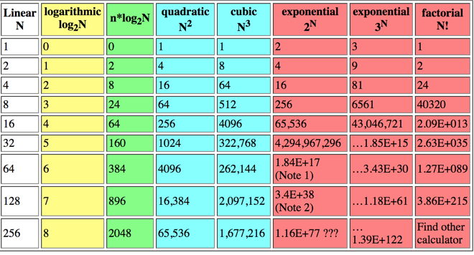
Table of growth rates
http://jcsites.juniata.edu/faculty/kruse/cs240/algcomplex.htm

Slide 27
14. Recursive search and sort
Recursive binary search
Performance analysis
Mergesort
Mergesort analysis

Slide 28
14. Recursive Search and Sort
1.1–1.2

